Slide 1

Space-Based Architecture

Slide 2
MENU
Track
Why
What
App

Slide 3
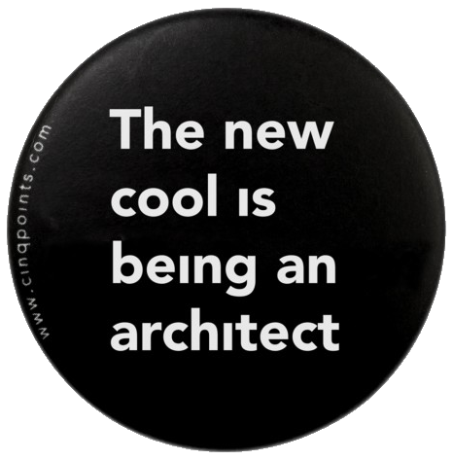
this session?
We’re all on the way to becoming an architect but there are no shortcuts
An « Azure Architect » will become irrelevant
An « architect » will never go out of fashion
Notes:
Why this session: Architecture is not about the latest, greatest and shiniest. In that way, architecture is actually pretty boring. (Message Queue=1983)
You can learn some cloud and become a “Cloud Architect”. Without the basics, without the fundamentals, you are not a “Cloud Architect”, you are a “Cloud Developer”
Plus other pitfalls: “Everything looks like a nail” + Cloud will go out of style at some point in your career all your AWS/Azure knowledge will become irrelevant.
The latest, greatest and shiniest will either be late in this track or could be a technical session instead, or a complete new “Cloud Track”...

Slide 4
Focus of this Track
Different Architectures
Dependency Management
Design
Best Practices
UnitTesting
Notes:
Different Architectures: We will, obviously, be covering the different architectures so that you know your options when you have to design a system. And it will make it easier to understand an existing architecture if a well-known architecture was used. Each architecture also has a certain score for the itilities: maintainability vs speed of development vs debuggability …
Dependency Management: The bread and butter of an Architect. Dependency Inversion is an amazing tool here but remember that an IOC container is just a library that has little to do with Dependency Management from an architects standpoint.
Design: Design & Patterns: in greenfield development (mini frameworks) or in brown field development (introducing patterns)
Best Practices: XP, linting, testing, CI/CD, diagrams. But also low level stuff: comments, naming things, function length, …
UnitTesting: State vs Behavior testing. Mocking: Stubs, Fakes, … TDD, What to test, Importance of a test failing at least once + Piggy Gonzales.
If you know everything there is to know about UnitTesting, it is up to you, the architect to either try to incorporate UnitTesting in the team, set it up on the CI or help other teammembers understand UnitTesting, and convince them of the worth and help them when they have issues writing a test for a certain case.

Slide 5
WHY
Traditionally as a system needs to handle more concurrent users, the database becomes the bottleneck and is scaled up. SBA was created specifically for systems that have unpredictable spikes of concurrent users.
Notes:
Scale Up: Bigger machines which start to cost exponentially more and can only be scaled up so much. Possible downtime during a switch. Then start with caching & replication (which already is scaling-out)
SBA: Caching & replication is handled from the get-go with the architecture vs retro-fitting scaling out an existing architecture
History: By Microsoft in 1997. “MSN Customer marketing data store” a multi-terabyte in-memory DB shared by all MSN sites.
Usage: Financial Services & Telecom. Trading Platforms. Social Media Platforms, Bidding & Auction Apps. Ticket Sales.

Slide 6
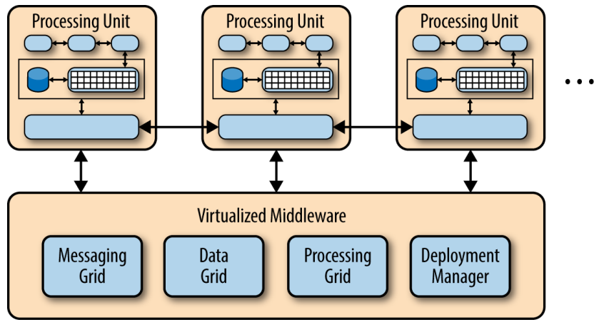
What
A Space-based architecture (SBA) is an approach to distributed computing systems where the various components interact with each other by exchanging tuples or entries via one or more shared spaces.
Notes:
Compared with a Message Queue in that both are built on the idea of a distributed exchange of messages.
A Tuple is a data structure containing 1 to n elements that may not be of the same type. (aka a record)
Tuple Space: Distributed Shared Memory. A repository/bag of Tuples that are accessed concurrently by all processing units for reading and/or writing.
Processing Unit: The thing that scales linearly. More work? Spin up additional “processing units”. Exchange of POJOs or POCOs.

Slide 7
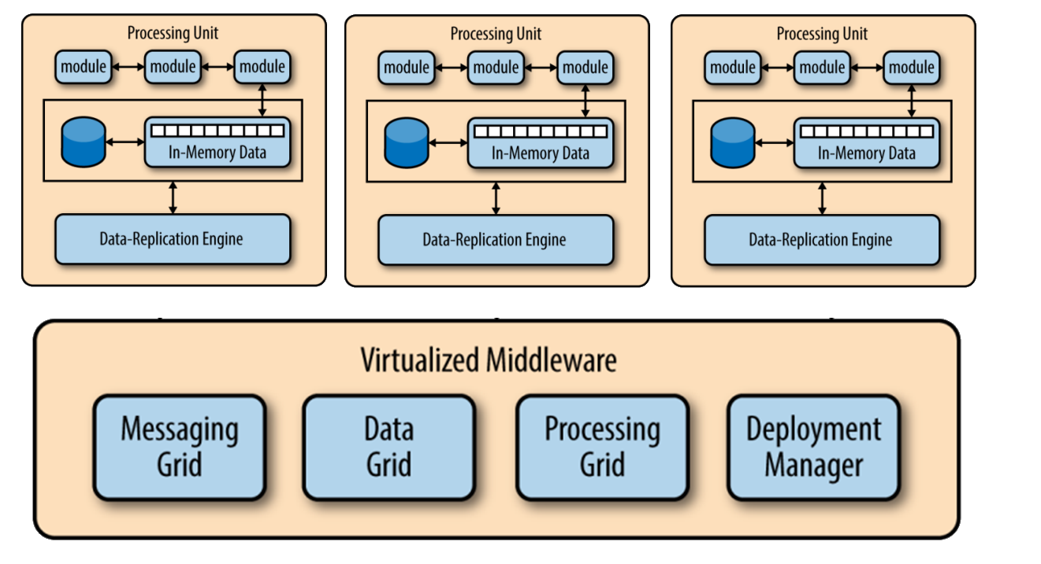
Notes:
Messaging Grid: Handles incoming requests by loading them off to an available processing unit that can handle the message. Keep track of user sessions.
Round-Robin Scheduling: each processing unit gets the same amount of time slices. Priority Scheduling: biggest or remote box first or most important messages first.
Data Grid: Replicated in-memory data grids. Optionally synchronizes with an underlying db.
Processing Grid (optional): For larger applications there can be different types of processing units (ex: Orders & Customers Processing Units). Could also act as a mediator between different types of Processing Units.
Deployment Manager: Monitors the system and spins up additional processing units as load increases and tears them back down when no longer needed.
Data Pumps: Data Reader/Writer: Persistence from/to the database as startup/shutdown.
Master-Slave: Multiple masters that pass work to slaves which are configured to be able to handle any task a master might give them.

Slide 8
SBA and Agile
Communication: nTiered is technical while SBA makes sense to business.
Maintainability: Requests from different stakeholders are already split up in different spaces.
Notes:
Communication: Organised by “business purpose”: Processing Units offering services that exchange data (Blackboard Metaphor)
You have some data and someone works on it, updates the data, then the next person works on it – Like a form
Maintainability: Cost of change is lineair, big change to the model, big change to the code/data.

Slide 9
RESOURCES
Site: DeveloperToArchitect
Use Case: Virgin Mobile
Book: Software Architecture Patterns
Youtube: MicroServices vs SBA

Slide 10
Questions?

Slide 11
Next Architectures
n-tier, Onion, Hexagonal
Event Driven - 15
Microkernel Architecture - 9
Event Sourcing & CQRS - 9
MicroServices - 9
Serverless - 2
Broker Architecture - 14

Slide 12
Architecture app brainstorm
Notes:
https://lucid.app/lucidspark/29e08ab1-0e25-4a0e-836f-dff1e5773c76/edit?invitationId=inv_9610f85b-a404-4bf0-bdf2-198ce7983fda#

Slide 13
Next StepS
Setup second meeting « opleidingsplan »
Second Architecture Track Session?
The Return Of The Socks Store™ (Vue 2->3, React 16->18)
Redux Training

Slide 14
Sessions
Uniform development standards
Architectures (n-tier, event driven, microservices, …)
Explore how an Enterprise Framework could work
Design
Introductionary Session
Real world use case (your project?)
Small Frameworks
Brown Field Development & UnitTesting
Communication (Persuasion, Compromising, …)
Non Functionals (Security, Maintainability, …)
Performance (Db, Profilers, …)
UML & ERD
Dependency Management & Dependency Inversion
Notes:
Uniform development standards:
Some acronyms (DRY, YAGNI, …)
Development standards enforcement (.editorconfig, linting, UnitTesting on CI, compiler warnings, gitignore/comments/…, …)
Low level coding guidelines (comments, tabs vs spaces, function length vs bugs correlations, …)
Architectures: n-tier, hex, onion, CQRS, event sourcing, microservices, serverless, microkernel aka plugin, space based aka cloud architecture

Slide 15
Implementations
GemFire, JavaSpaces,
GigaSpaces, IBM Object Grid, nCache,
and Oracle Coherence

Slide 16
JavaSpaces
put
notify
get
read

